Slide 1
What are we going to learn?
李宏毅
Hung-yi Lee

Slide 2

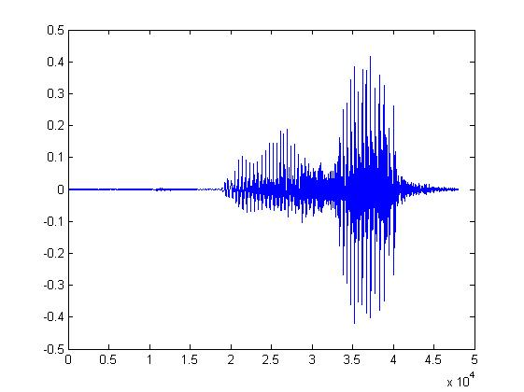

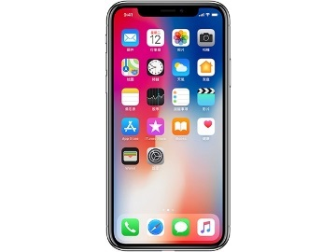
System
A system has input and output (function, transformation, operator)
Speech Recognition System
“How are you”
Dialogue System
(e.g. Siri, Alexa)
“How are you”
“I am fine”
Communication System
“Hello”
“Hello”
Notes:
Can have multiple inputs and outputs

Slide 3
Linear System
Linear system have two properties
1. Persevering Multiplication
2. Persevering Addition
Linear
System
Linear
System
x
y
kx
ky
x₁
Linear
System
y₁
x₁+x₂
Linear
System
y₁+y₂
x₂
Linear
System
y₂
Notes:
只要符合这两个定义，就是线性系统

Slide 4



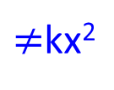




Linear System
System
x
x²
Linear system have two properties
1. Persevering Multiplication
2. Persevering Addition
Linear
System
Linear
System
x
x²
kx
k²x²
$≠$kx²
$$x_{1}$$
Linear
System
$${\left(x_{1}\right)}^{2}$$
$$x_{1}+x_{2}$$
Linear
System
$${\left(x_{1}+x_{2}\right)}^{2}$$
Linear
System
$$x_{2}$$
$${\left(x_{2}\right)}^{2}$$
$$≠{\left(x_{1}\right)}^{2}+{\left(x_{2}\right)}^{2}$$

Slide 5








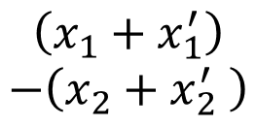





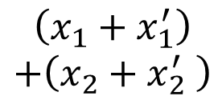









Linear System
$$x_{1}$$
System
$$x_{1}+x_{2}$$
$$x_{2}$$
$${x_{1}−x}_{2}$$
Two properties
1. Persevering Multiplication
2. Persevering Addition
$$x_{1}$$
System
$$x_{1}+x_{2}$$
$$kx_{1}$$
System
$$kx_{1}+kx_{2}$$
$$x_{2}$$
$${x_{1}−x}_{2}$$
$${kx}_{2}$$
$${kx_{1}−kx}_{2}$$
$$x_{1}$$
System
$$x_{1}+x_{2}$$
$$\left(x_{1}+x_{1}^{′}\right)$$
$$+\left(x_{2}+x_{2}^{′} \right)$$
$$x_{2}$$
$$x_{1}+x_{1}^{′}$$
$${x_{1}−x}_{2}$$
System
$$x_{1}^{′}$$
System
$$x_{1}^{′}+x_{2}^{′}$$
$$x_{2}+x_{2}^{′}$$
$$\left(x_{1}+x_{1}^{′}\right)$$
$$−\left(x_{2}+x_{2}^{′} \right)$$
$$x_{2}^{′}$$
$${x_{1}^{′}−x}_{2}^{′}$$

Slide 6
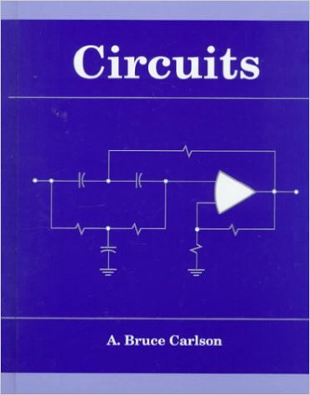


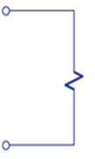
Applications
Most system are (assumed to) be linear
Input: voltage source, current source
Linear
output: voltage and current on the load (燈泡、引擎)
Circuit
+
-
input
output
(大一必修)
Linear System
Notes:
Desing filtering

Slide 7
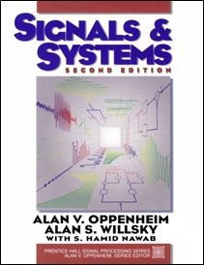

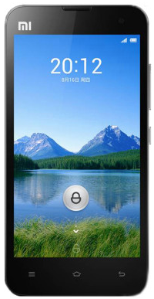

Applications
Most system are (assumed to) be linear
Communication System
Linear
Channel
Transmitter
Receiver
Linear System
(大二必修)
Notes:
像無線通訊訊號在介質中的傳播就可以用線性系統來模擬

Slide 8
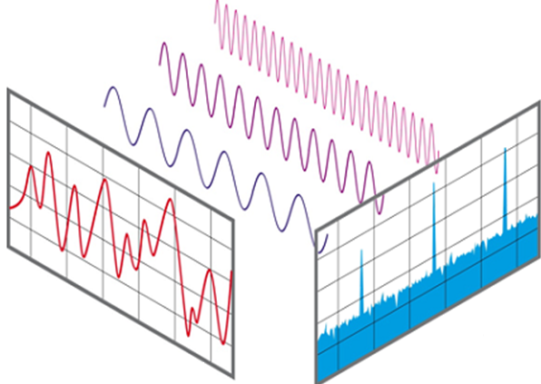
Applications
time
frequency
Fourier
Transform
(大二必修)
Linear System (Transform)

Slide 9
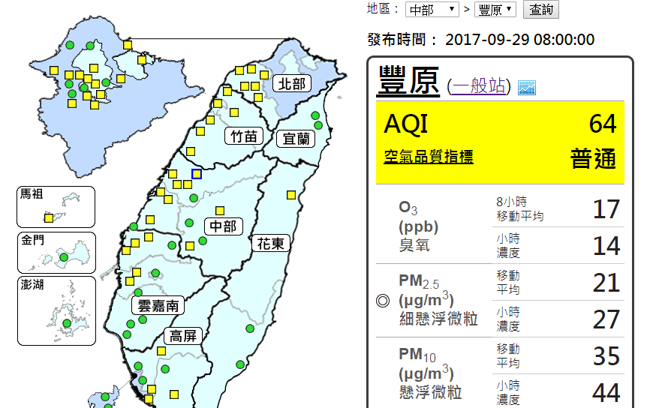
Applications
預測豐原站在下一個小時會觀測到的 PM2.5

Slide 10
Applications
y: A 年 B 月 C 日 N 時的 PM2.5
x_{K}: A 年 B 月 C 日 N – K 時的 PM2.5 觀測值
x₁
氣象
預報
x₂
y
x₃
Linear system
y = w₁x₁ + w₂x₂ + w₃x₃
Where do w1, w2 and w3 come from?
Notes:
Other application
假设线性好算，同时和真实的世界（非线性）相比，误差很低
算w1,w2,w3靠机器学习

Slide 11
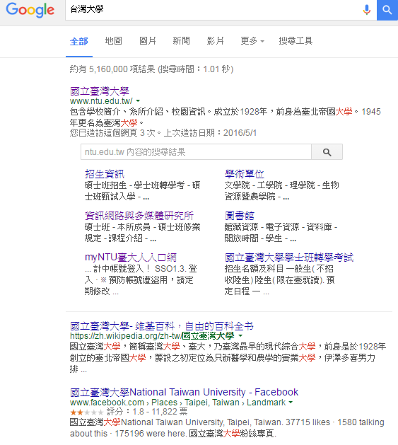

Applications
P336 of Textbook
http://incomebully.com/does-pr-pagerank-still-matter/
Notes:
How to rank

Slide 12


Applications - PageRank
hyperlink

Slide 13
Applications - PageRank
很多網頁連到
被重要網頁連到
很多網頁連到

Slide 14
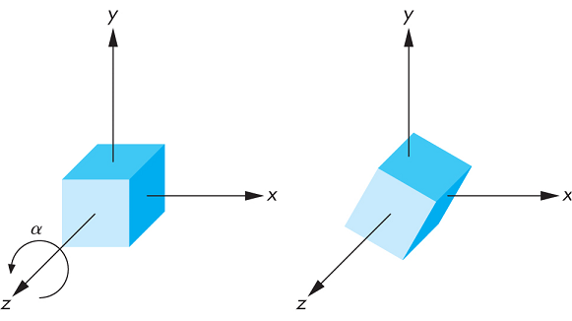


Applications - Computer Graphics
Section 7.9 of Textbook
Linear
System
$$\left[\begin{matrix}x^{′} \\ y^{′} \\ z^{′}\end{matrix}\right]$$
$$\left[\begin{matrix}x \\ y \\ z\end{matrix}\right]$$
http://www.c-jump.com/bcc/common/Talk3/Math/Matrices/Matrices.html
Notes:
Rotation

Slide 15
What are we going to learn?
Beyond vector in Chapter 6
Chapter 1, Chapter 2, Chapter 3
?
Linear
System
3
?
6
vector
vector
……
……
?
9
Does it have solution?
Does it have unique solution?
How to find the solution?
Determinants (行列式)
Beyond 3 X 3
Different view from high school
Notes:
Higher dimension
Solving a system of linear equations
Approximate Solution
Vector是广义的：一个function或者一个讯号也是一个vector

Slide 16
What are we going to learn?
Simpler
Linear
System
…
…
Chapter 4
How to describe this “set”?
Change the description
Linear
System
Approximation
…
…
Chapter 7
Notes:
Higher dimension
线性系统所有可能的输出的集合

Slide 17












What are we going to learn?
Chapter 5: EigenXXX
Enlarge the input
Decrease the input
$$x_{1}$$
Linear
System
$${2x}_{1}$$
$$x_{1}^{′}$$
$${0.5x}_{1}^{′}$$
Linear
System
$$x_{2}$$
$${2x}_{2}$$
$$x_{2}^{′}$$
$${0.5x}_{2}^{′}$$
……
……
……
……
$$x_{n}$$
$${2x}_{n}$$
$$x_{n}^{′}$$
$${0.5x}_{n}^{′}$$
Filter

Slide 18
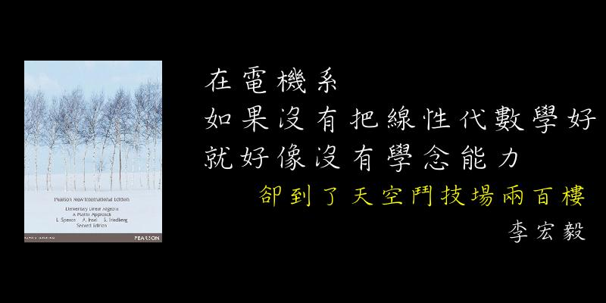
Linear Algebra is Important
Notes:
Dimension reduction
http://math.mit.edu/~edelman/publications/first_annual.pdf
https://sciencing.com/linear-equations-used-everyday-life-6022370.html
https://www.quora.com/Is-traffic-light-system-application-of-linear-algebra-If-yes-then-how-Explain-briefly
http://www.m-hikari.com/ijcms/ijcms-2014/13-16-2014/aduIJCMS13-16-2014.pdf
http://www.math.tamu.edu/~yvorobet/MATH304-504/Lect1-03web.pdf

